Slide 1

Yelp Review Analysis
Data Rovers: Kunlun Liu | Tong Zhang | Zhiwei Zhang

Slide 2
Content
Introduction
ETL + Database
Exploratory Statistics
Background
Vision
Raw Data
ETL
SQL Database
Price range and Ratings
Restaurants Categories
Income Exploration
Machine Learning
Visualization
Conclusion
Fake Review
Model Analysis
Sentiment Analysis (Restaurant Features)
Fake Review
Restaurant features
Additional Works
Conclusion
Reference
Q & A

Slide 3
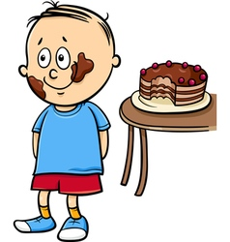

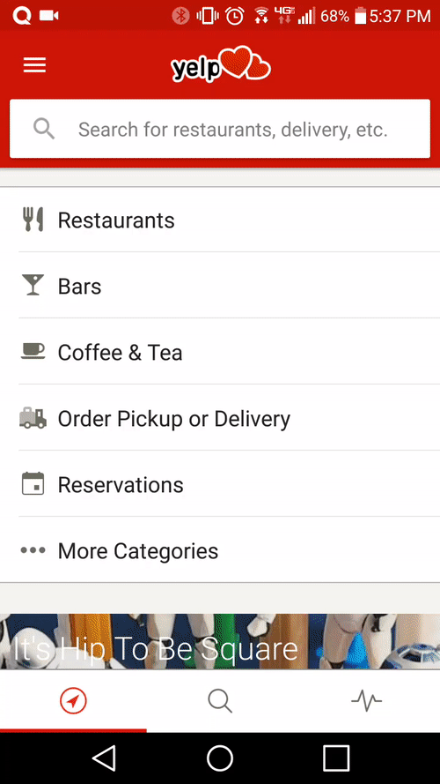

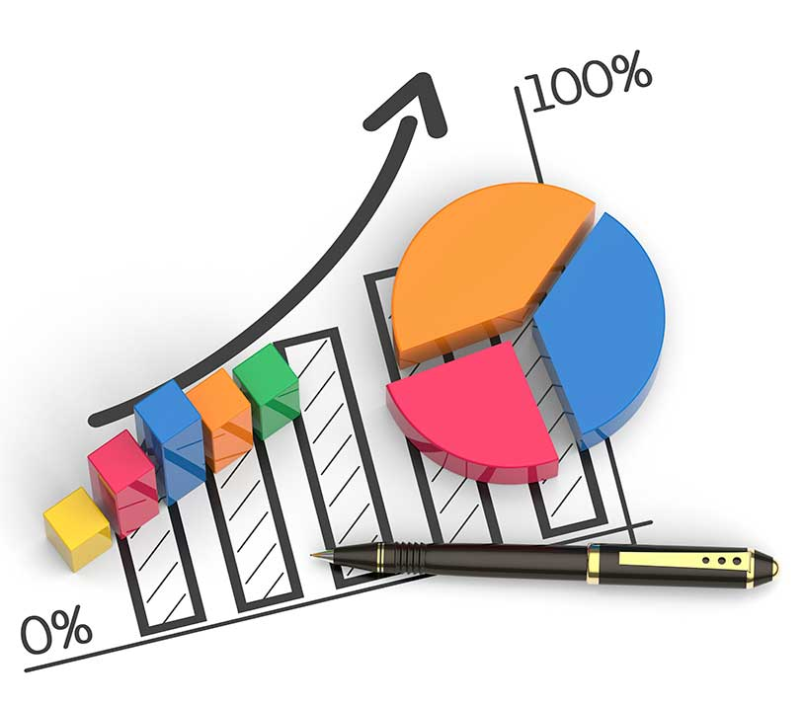
Background
Market Opportunity ?
User Experience?
Introduction | ETL+DB | Statistics | Machine Learning | Visualization | Conclusion

Slide 4

Problem & Vision
In order to find out ways that we can improve Yelp’s functionality, we would like to dive deep into Yelp’s datasets as well as some extra datasets in order to retrieve useful information that could help Yelp’s original purpose:
Help customer understand merchants better
Assist new merchant entering the market
Assist existing merchant in growing their businesses.
Introduction | ETL+DB | Statistics | Machine Learning | Visualization | Conclusion

Slide 5

Approaches:
Train machine learning models on labeled review dataset
Predict if a given new review is fake or not
Utilize machine learning techniques as well as natural language processing tools to retrieve most relevant keywords in the reviews that affects review scores.
Incorporate average household income dataset which describes the income information in 6 states (PA, NV, NC, IL, OH, and AZ )
Introduction | ETL+DB | Statistics | Machine Learning | Visualization | Conclusion

Slide 6
Raw DataInformationz
Review.Json
full review text , user_id, business_id t date
Review
Income & Zipcode
County, state, households, different types of income,
Zipcode, city, county, state
Income & Zipcode
Business.Json
Business
location, stars rate, hours, categories, attributes
Fake Review Label
Fake Review Label
User
User.Json
Yelp reviews with fake verus true labels from an accredited research group
Review count, fun, userful, compliment_cute
Introduction | ETL+DB | Statistics | Machine Learning | Visualization | Conclusion

Slide 7

Data Cleaning Informationz
Business: 156, 639 21, 380
Restaurant / is_open
PA, NV, NC, IL, OH, and AZ
Review: 4,736,897 1,978,502
Introduction | ETL+DB | Statistics | Machine Learning | Visualization | Conclusion

Slide 8
Data Cleaning IInformationz
Income_Zipcode Cleaning Process
Merge Income data and zipcode data by their unique combination of county and state name
State names change to shorthand
All datasets lower case
County without “county” suffix
Merge two datasets
Make a unique column
Combines county and state names
Export a csv with zipcode, county, states, and average income
1
2
3
4
5
Goal
To understand how income vary from city to city (or county to county)
Able to compare with restaurants’ price range with that county’s income level
Introduction | ETL+DB | Statistics | Machine Learning | Visualization | Conclusion

Slide 9
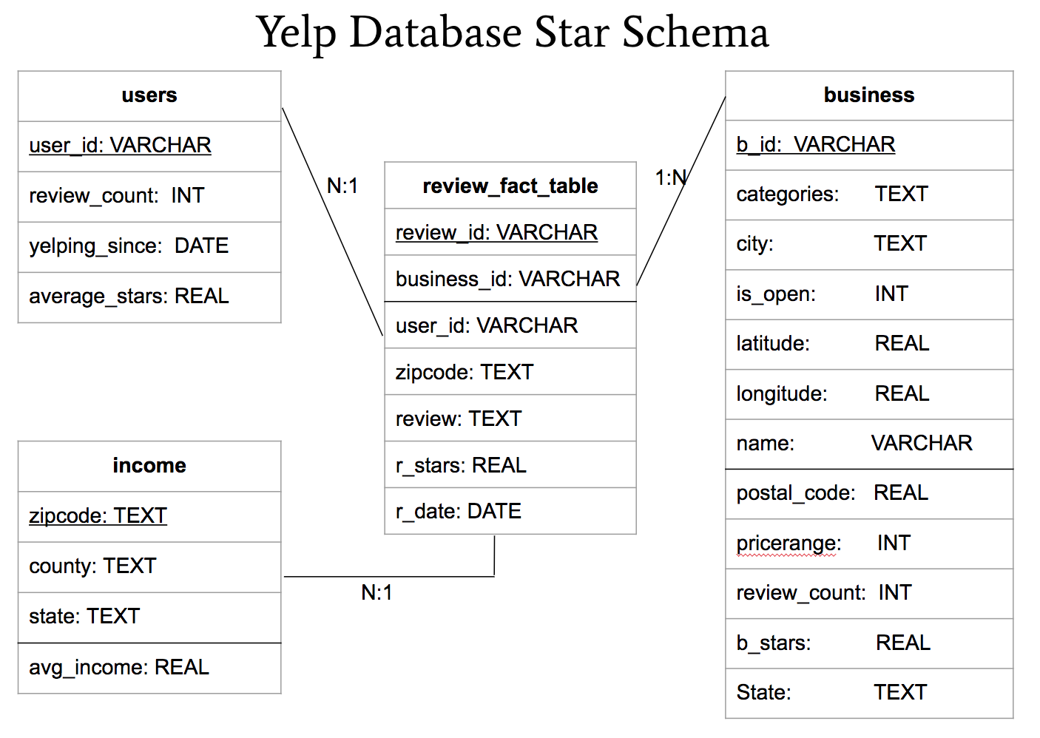
SQL Database
A review id can only identifies one user, one business, and one zipcode.
An user can have multiple review id
A business can have multiple review id
A zipcode can have multiple review id
A zipcode can provide the city information about the business.
Business_id, user_id, and zipcode are all foreign keys for review_fact_table.
Introduction | ETL+DB | Statistics | Machine Learning | Visualization | Conclusion

Slide 10
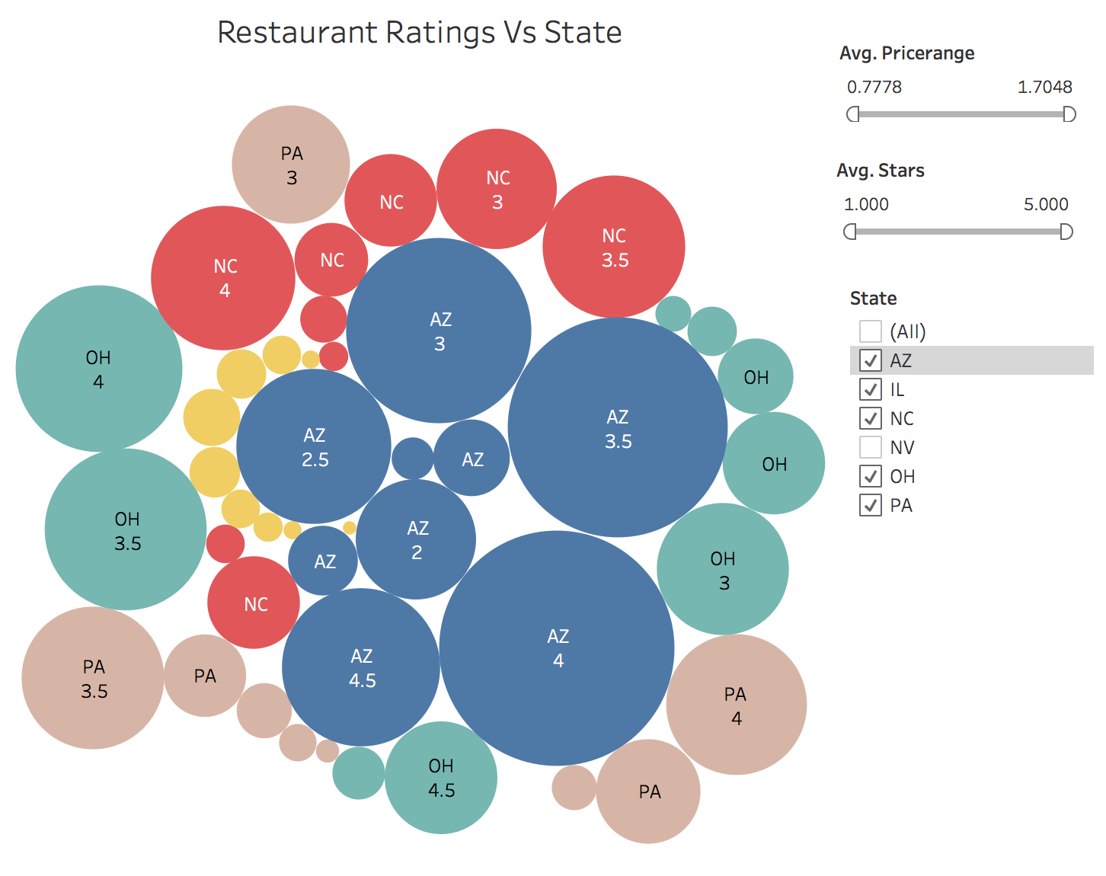
Exploratory Statistics: Rating Vs States
Introduction | ETL+DB | Statistics | Machine Learning | Visualization | Conclusion
Notes:
Size = number of restaurants that has a 1-5 stars

Slide 11
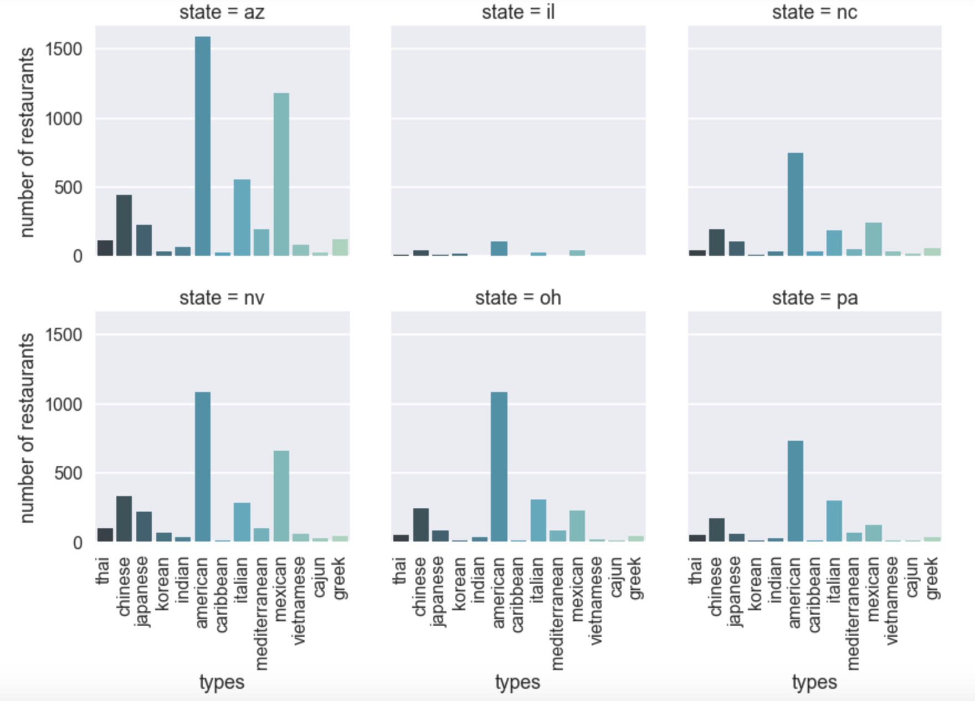
Exploratory Statistics: Restaurants Categories
AZ has the most number of restaurants, and IL has the least
American and Mexican restaurants have the highest number in all states
Italian and Chinese restaurants are also in great numbers
Introduction | ETL+DB | Statistics | Machine Learning | Visualization | Conclusion

Slide 12
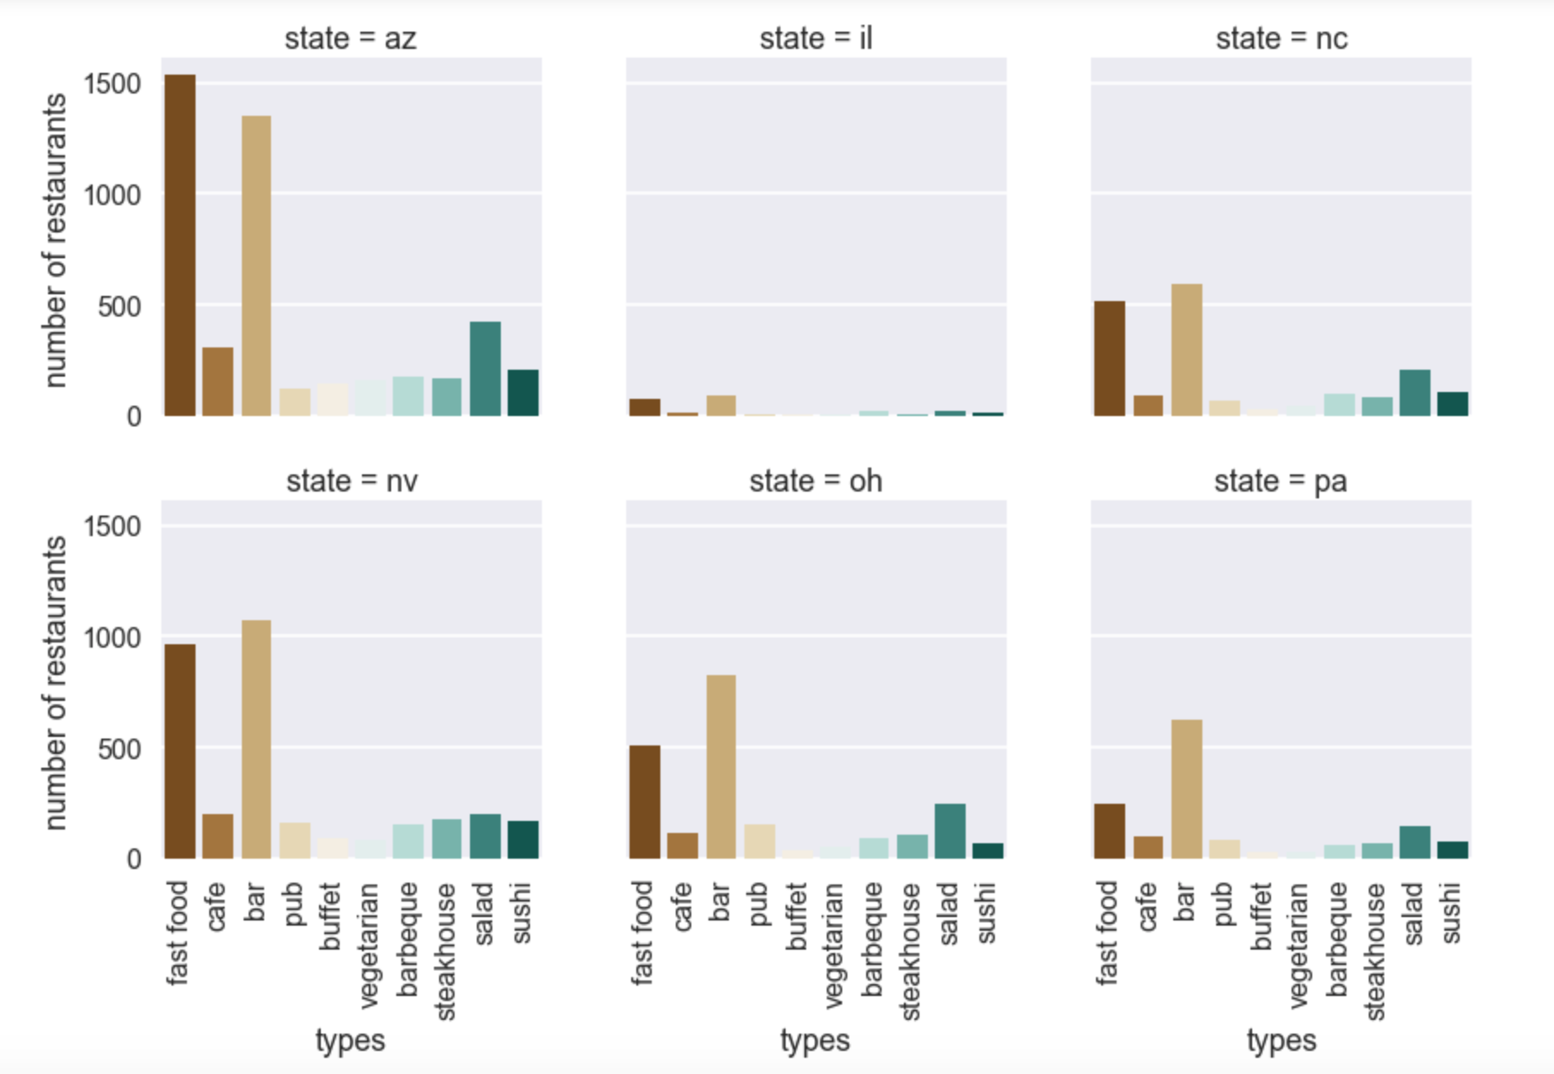
Exploratory Statistics: Restaurants Categories
AZ has the highest numbers of fast food restaurants and bars
OH and PA has much less fast food restaurants than bars
Salad restaurants also has a leading number of restaurants in each state
Introduction | ETL+DB | Statistics | Machine Learning | Visualization | Conclusion

Slide 13
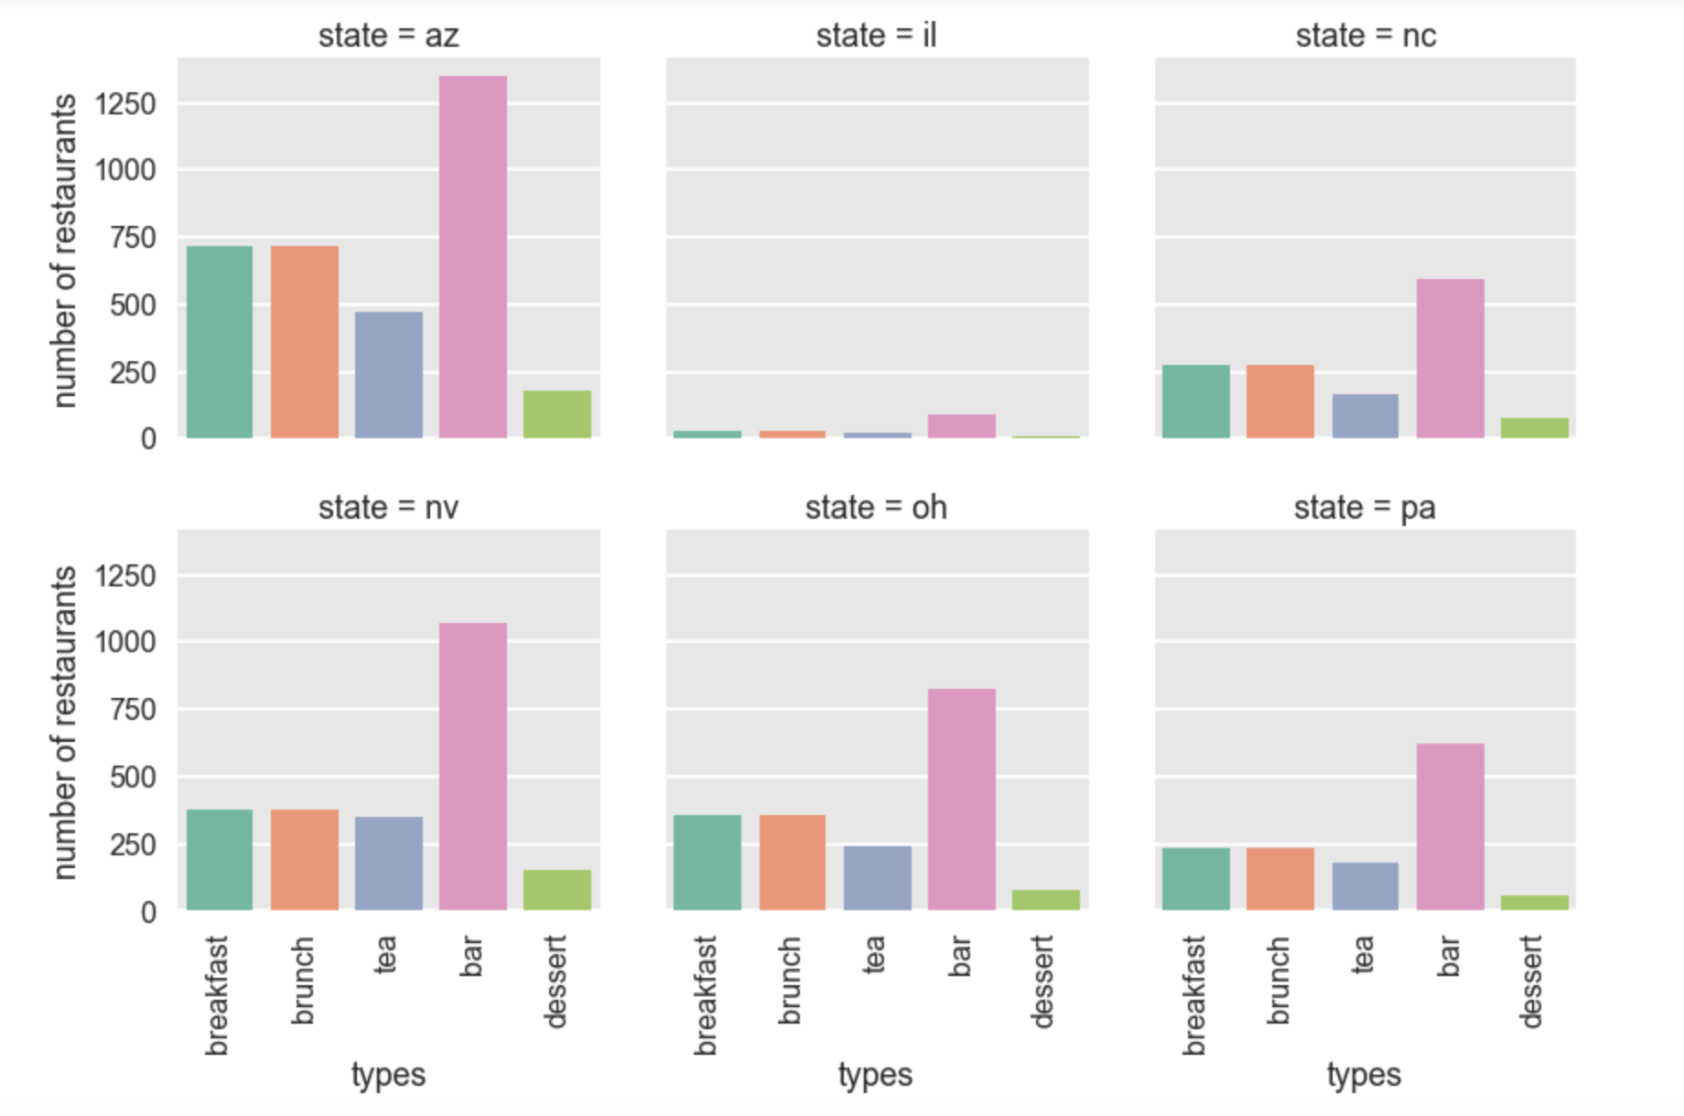
Exploratory Statistics: Restaurants Categories
With similar breakfast, brunch, tea restaurants, OH has less bars than NV
NV’s number of breakfast, brunch, and tea restaurants is much balanced than any other state’s number of restaurants
Introduction | ETL+DB | Statistics | Machine Learning | Visualization | Conclusion

Slide 14
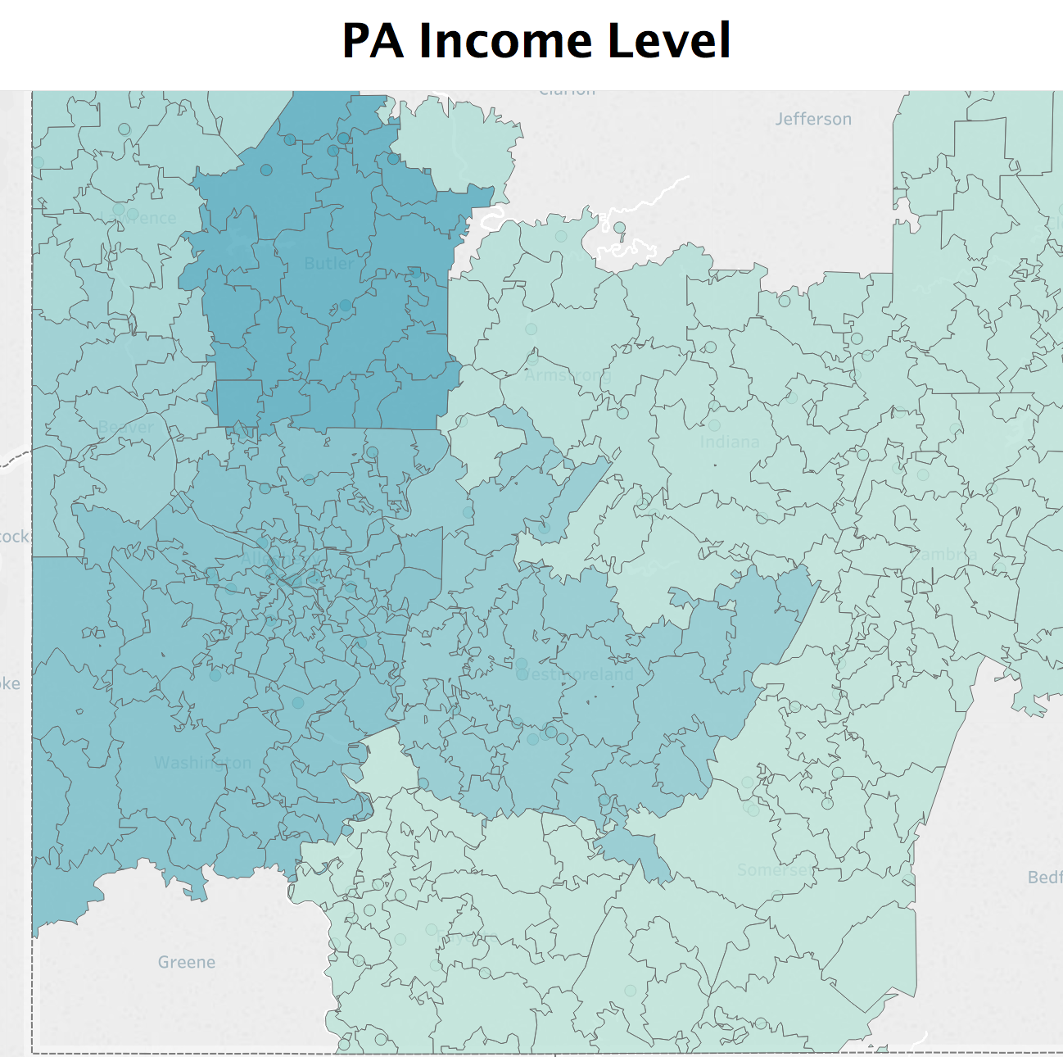
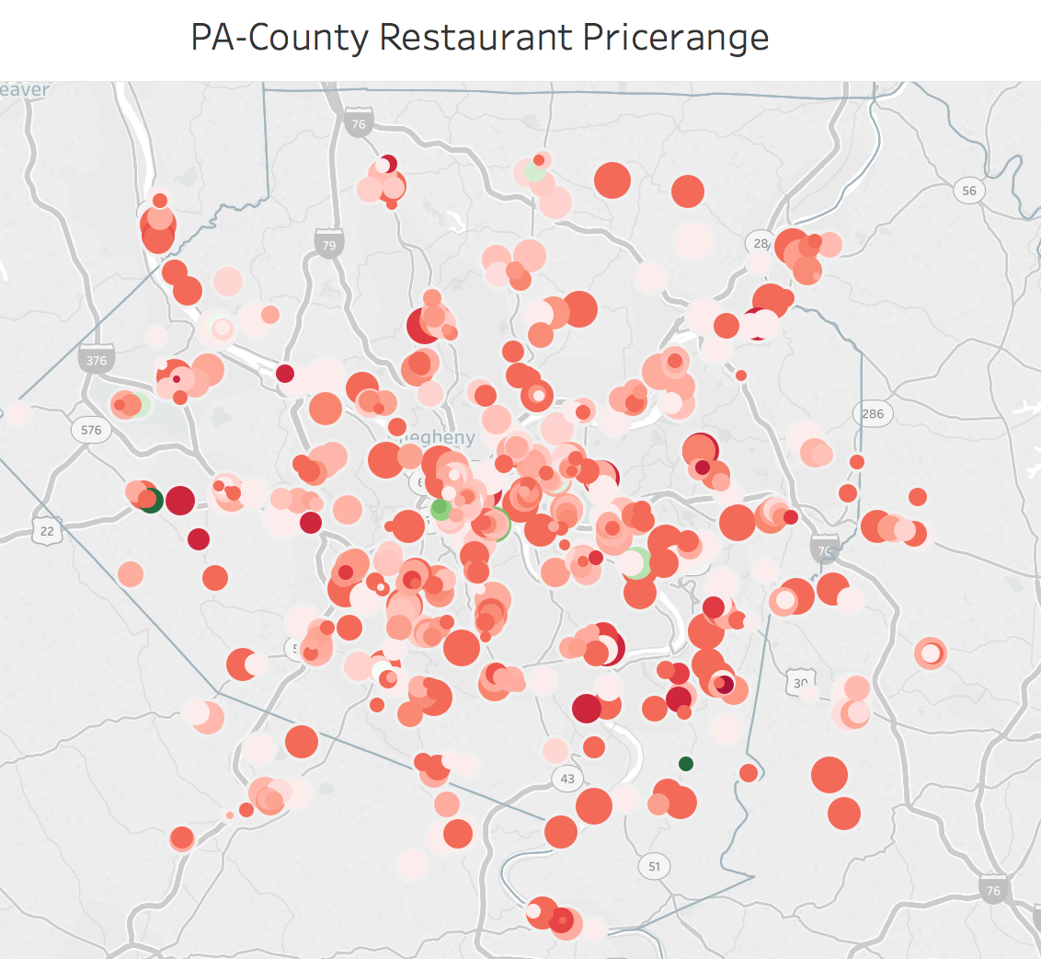
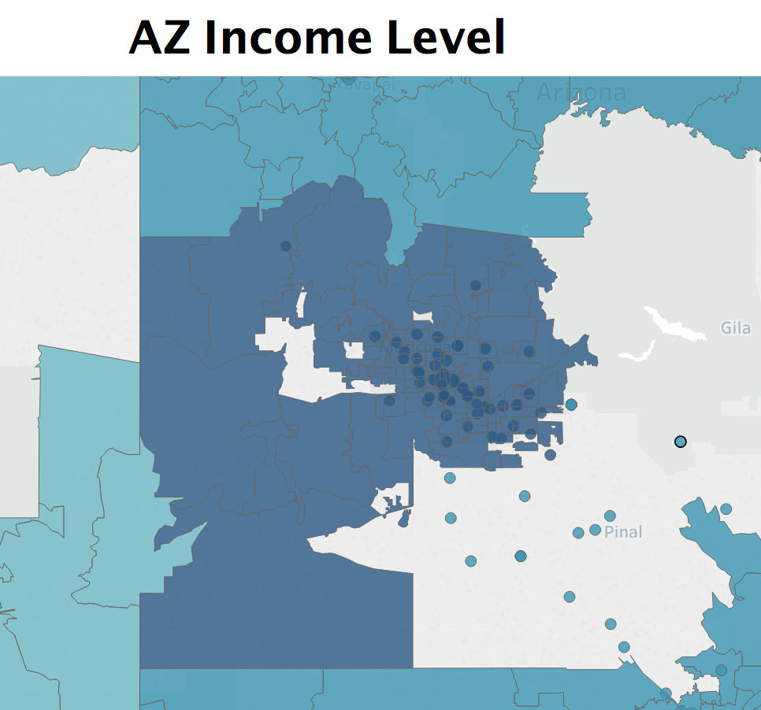
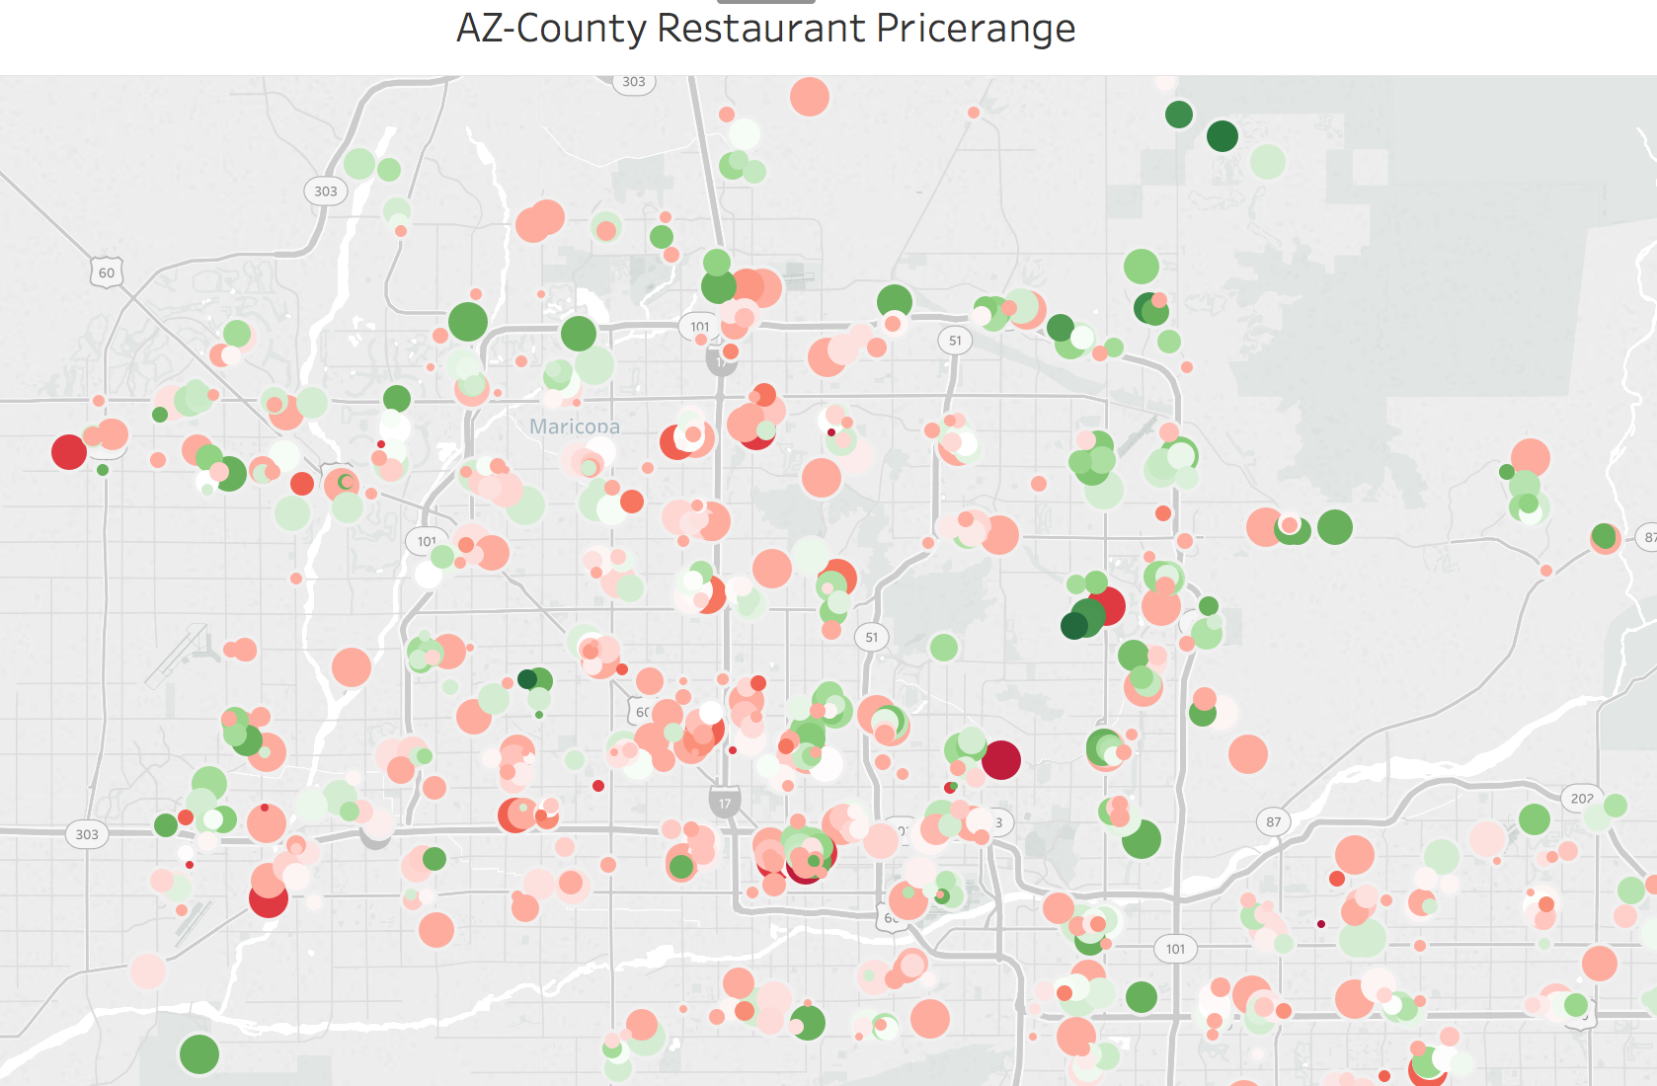
Exploratory Statistics: Income Vs Price Range
Green --- > higher income
Green --- > higher price-range
Introduction | ETL+DB | Statistics | Machine Learning | Visualization | Conclusion

Slide 15

Machine Learning on Fake Reviews I
Training dataset:
Data Source: Labeled Yelp Reviews
Data Size: 350000 rows
Unbalanced (True/Fake): 10:1
Assumptions:
Model prefers True Reviews
Remove Positive Reviews
Duplicate Negative Reviews
Introduction | ETL+DB | Statistics | Machine Learning | Visualization | Conclusion

Slide 16
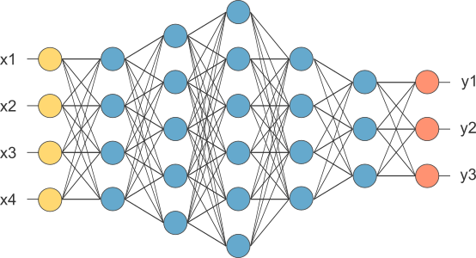
Machine Learning on Fake Reviews II
Training layers and parameters:
Convolutional layer
Maxpooling layer
Dropout layer
LSTM layer
Dense layer
Advantages of CNNs:
High Accuracy
Low Computational Expense
Input Chunks as Learning Samples
Eg. [“My teammates are smart”, “And they are pretty”]
[“my”, “teammates”, “are”, “smart”]
CNN
Introduction | ETL+DB | Statistics | Machine Learning | Visualization | Conclusion

Slide 17
Fake Reviews Model Analysis
Support Vector Machine
Medium Efficiency
Good accuracy
Overall proper model
Naive Bayes
Great Efficiency
High accuracy
Bad performance when working with unbalanced data
SVM >> NB because NB is likely to be biased by the majority of the labels of the data
Introduction | ETL+DB | Statistics | Machine Learning | Visualization | Conclusion

Slide 18

Machine Learning on Fake Reviews
Confusion Matrix
Predict | Fake | Not Fake
Fake | 69642 | 3854
Not Fake | 10323 | 118780
Predictive Modeling:
Ensemble SVM and CNNs
More weight to CNNs
Set threshold to 0.6
True
Report for Convolutional Neural Networks:
 | Precision | Recall | F1-score | Support
 | 0.87 | 0.95 | 0.91 | 73499
 | 0.97 | 0.92 | 0.94 | 129100
avg/total | 0.93 | 0.93 | 0.93 | 202599
Introduction | ETL+DB | Statistics | Machine Learning | Visualization | Conclusion

Slide 19
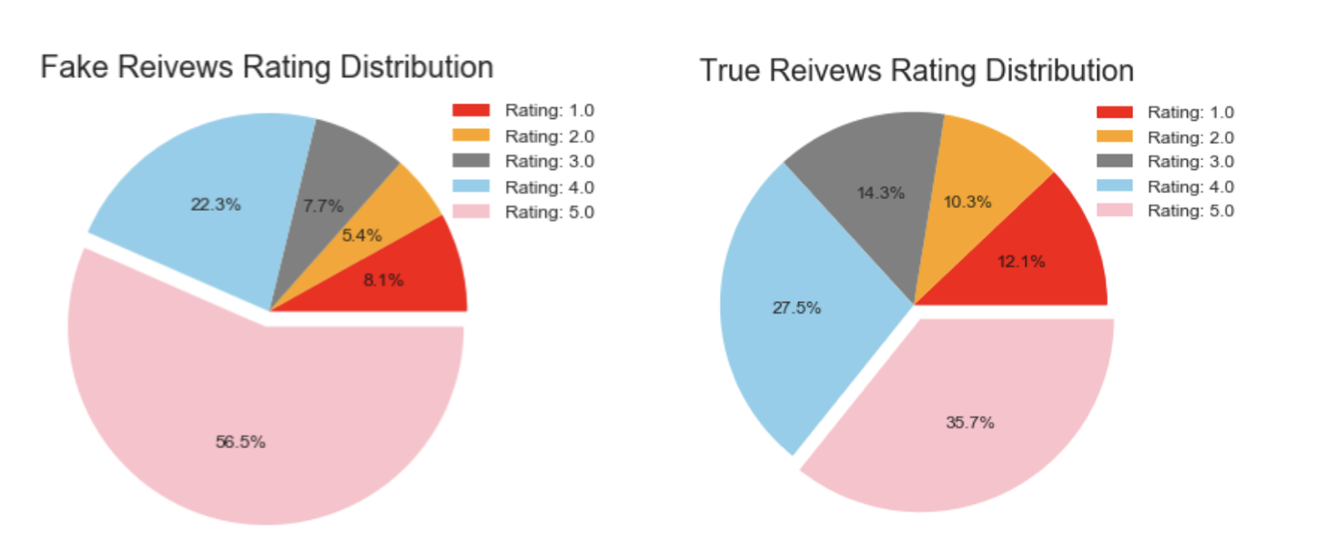
Visualization: Fake Review
Introduction | ETL+DB | Statistics | Machine Learning | Visualization | Conclusion
Notes:
The pie chart shows that fake reviews tends to rate more 5.0 ratings than true reviews, over 50% percent of the fake reviews are rated 5.0.

Slide 20
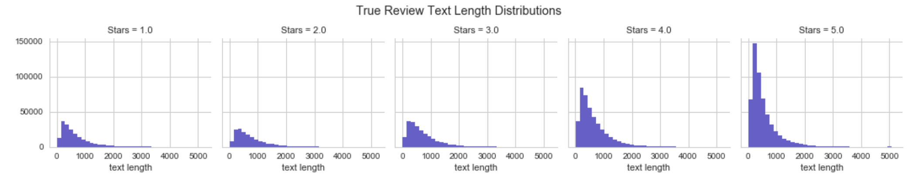
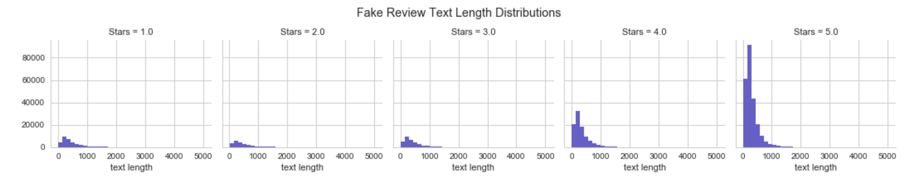
Visualization: Fake Review
Introduction | ETL+DB | Statistics | Machine Learning | Visualization | Conclusion

Slide 21

Information Retrieval Based on True Reviews
Word Cloud
Single Word Feature Selection
Bigram Feature Selection
Introduction | ETL+DB | Statistics | Machine Learning | Visualization | Conclusion

Slide 22

Word Cloud: Bag - of - Word
Review
Lower Case
Remove Punctuation
Tokenize
Bag of Word
Lemmatize Words
Remove stopwords
Introduction | ETL+DB | Statistics | Machine Learning | Visualization | Conclusion
Notes:
words in each review were separated and the punctuations were removed so that a “bag of words” was generated for each review. Finally, we stemmed, lemmatized and filtered out the stop words in each bag of words using both the in-built list in Python’s NLTK package.
a text is represented as the bag (multiset) of its words, disregarding grammar and even word order but keeping multiplicity.

Slide 23
Bag - of - Word
‘'Very nice food. Great to find our Indian taste in Vegas. The service was good as well. Overall, enjoyed the experience.'
['nice', 'food', 'great', 'find', 'indian', 'taste', 'vega', 'service', 'good', 'well', 'overall', 'enjoyed', 'experience']
Introduction | ETL+DB | Statistics | Machine Learning | Visualization | Conclusion

Slide 24
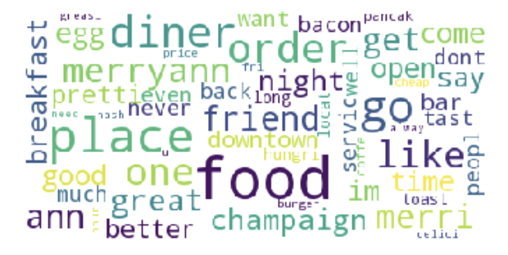
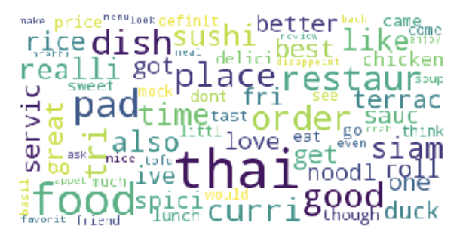
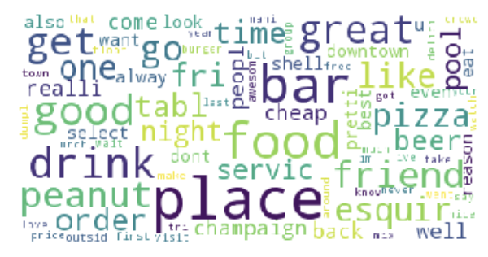
Visualization: Word Cloud
Introduction | ETL+DB | Statistics | Machine Learning | Visualization | Conclusion
Notes:
Word Cloud to give customer an overview of how frequent a word appears in the reviews for a particular restaurant at one glance. Below is the word cloud for Chipotle and you can expect to see words like mexican, taco and burrito. The larger the size, the more frequent a word is being mentioned.

Slide 25
Identifying Restaurant Features I
Count Word Frequency
Tf-idf
TF (Term Frequency)
x
IDF (Inverse Document Frequency)
{
Reward words having high occurrence in a review
}
{
Penalize words appearing many times in all reviews
}
Introduction | ETL+DB | Statistics | Machine Learning | Visualization | Conclusion

Slide 26
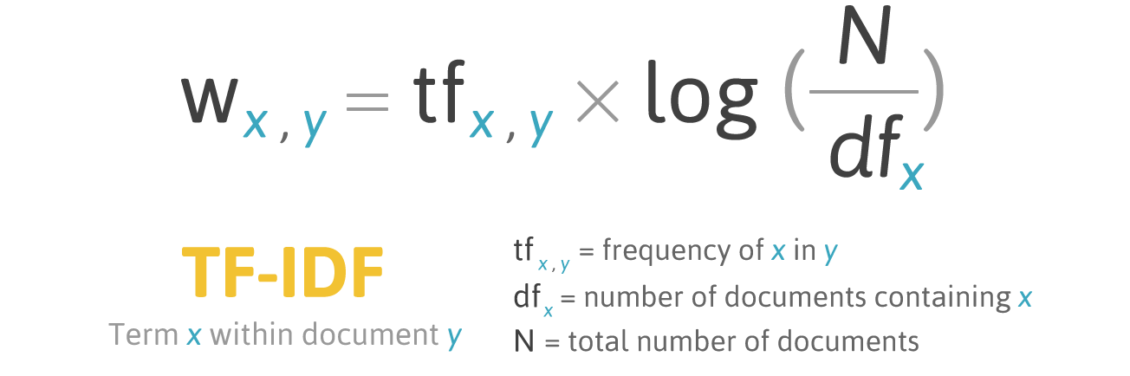
Identifying Restaurant Features II
TfidfVectorizer:
Combines Our Review vectors into m*n matrix containing our tf-idf scores
 | Review 1 | Review 2 | Review3
{amazing basil} | tf-idf scores | ... | ...
{appreciate texture} | ... | ... | ...
{best place} | ... | ... | ...
 | Review 1 | Review 2 | Review3
{‘amarican’} | tf-idf scores | ... | ...
{‘burger} | ... | ... | ...
{‘bar’} | ... | ... | ...
Introduction | ETL+DB | Statistics | Machine Learning | Visualization | Conclusion

Slide 27
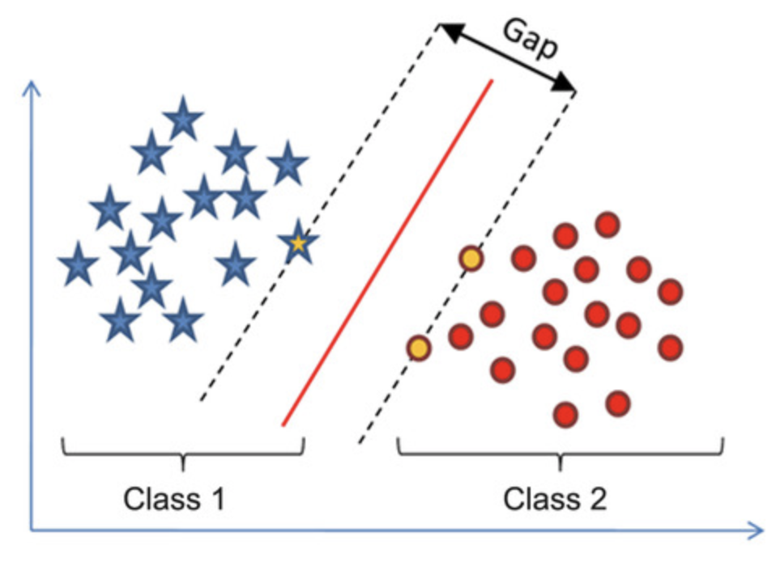
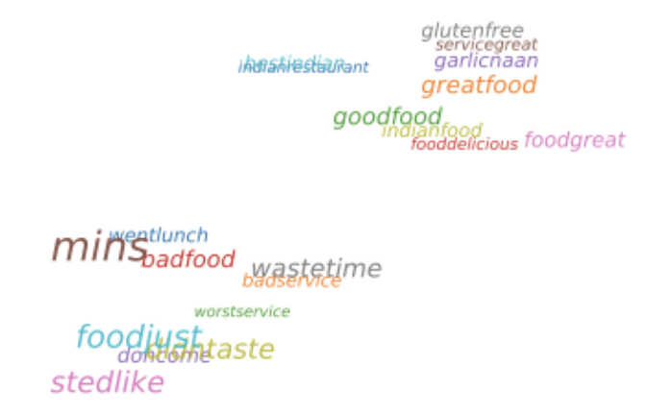
Identifying Restaurant Features II
Apply Support Vector Machines on the transformed data (tfidf matrix), using review rating as label.
Stars ≥ 3 as positive ‘1’ and Stars < 3 as negative ‘0’
Svm.coef_
Sign: positive / negative review
Absolute Size: how important the feature is for separating task
Introduction | ETL+DB | Statistics | Machine Learning | Visualization | Conclusion

Slide 28
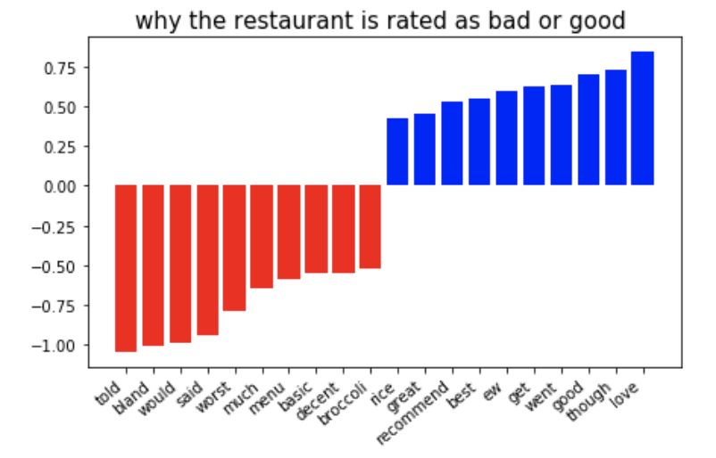

Visualization: one gram
Introduction | ETL+DB | Statistics | Machine Learning | Visualization | Conclusion
Notes:
The bar chart is created using weights obtained from svm.coef_ and important features based on the absolute size of coefficients. Blue bars correspond to important words in good reviews and red bars correspond to important words in bad reviews. For example, using one gram, we can see words…..

Slide 29
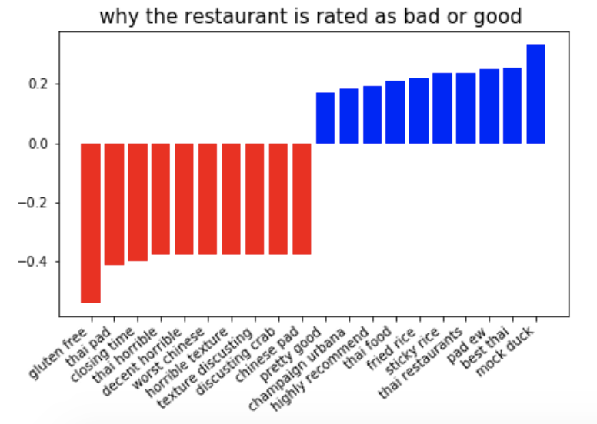
Visualization: bi-gram
Introduction | ETL+DB | Statistics | Machine Learning | Visualization | Conclusion
Notes:
In order to make the result more informative, we also did restuarant important features extraction for bigram.For this particular restaurant we are showing, we can see words like……. are more likely associated with bad reviews, we suggest that this restaurant should consider…..Within good reviews, we can see things customers appreciate, like……..

Slide 30
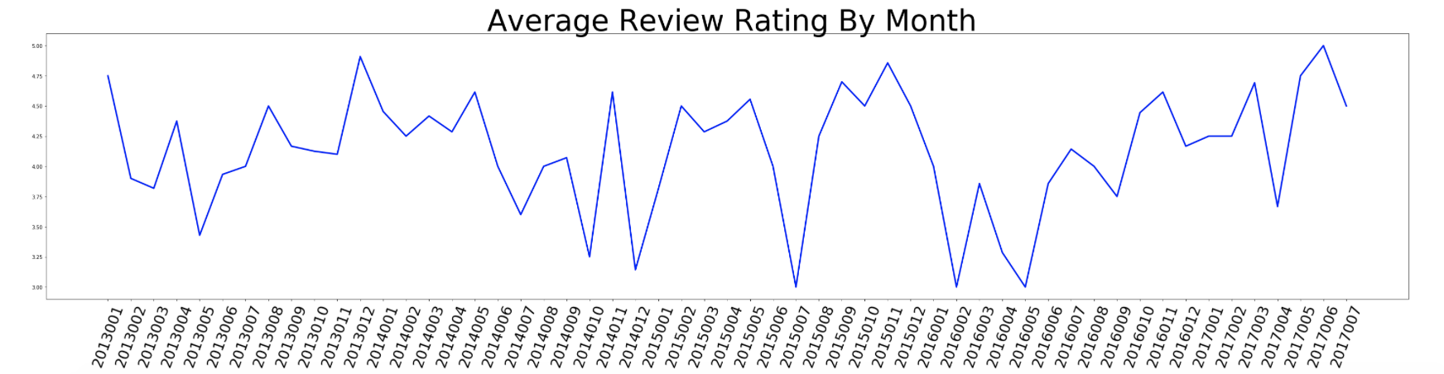
Visualization: Restaurant Review Rating Over Time
In addition to the top keywords, we present the average review score over time in a monthly scope for one particular restaurant.
This information will give merchants a good idea of how their business perform in any given month of the year
Introduction | ETL+DB | Statistics | Machine Learning | Visualization | Conclusion
Notes:
This information will give merchants a good idea of how their business perform in any given month of the year and, This also help merchants to notice changes in response to changes in business.

Slide 31
Additional Works
UI - instead of using zip code, we will improve our UI to make it more user friendly by utilizing cities and states.
CNN machine learning - we currently have unbalanced data for fake reviews, and if we balance the data, CNN performs worse. For the next step, we will try to supply the CNN model with more logical data.
Sentiment analysis - we only worked with English, but the reviews include Japanese, Chinese, and other languages. It would be great if we are able to find ways to process these reviews as well. Potential ideas are translation into English or using distinct grammar rules to process the data.
Efficiency of the model needs to be optimized in order to handle even larger yelp review data in the future.
Database - Explore other efficient database options
Introduction | ETL+DB | Statistics | Machine Learning | Visualization | Conclusion

Slide 32
Reference
https://www.yelp.com/dataset/challenge
https://factfinder.census.gov/faces/tableservices/jsf/pages/productview.xhtml?pid=ACS_16_1YR_S1902&prodType=table
https://www.gaslampmedia.com/download-zip-code-latitude-longitude-city-state-county-csv/
http://www.ics.uci.edu/~vpsaini/
https://medium.com/tensorist/classifying-yelp-reviews-using-nltk-and-scikit-learn-c58e71e962d9
http://www3.cs.stonybrook.edu/~leman/pubs/15-kdd-collectiveopinionspam.pdf
https://plot.ly/python/scatter-plots-on-maps/

Slide 33
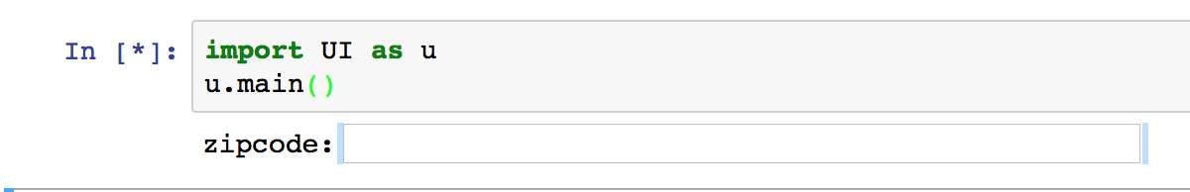
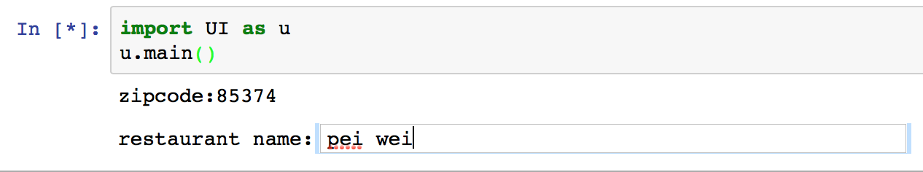
User Interface
User Input: { zip code, business name }

Slide 34
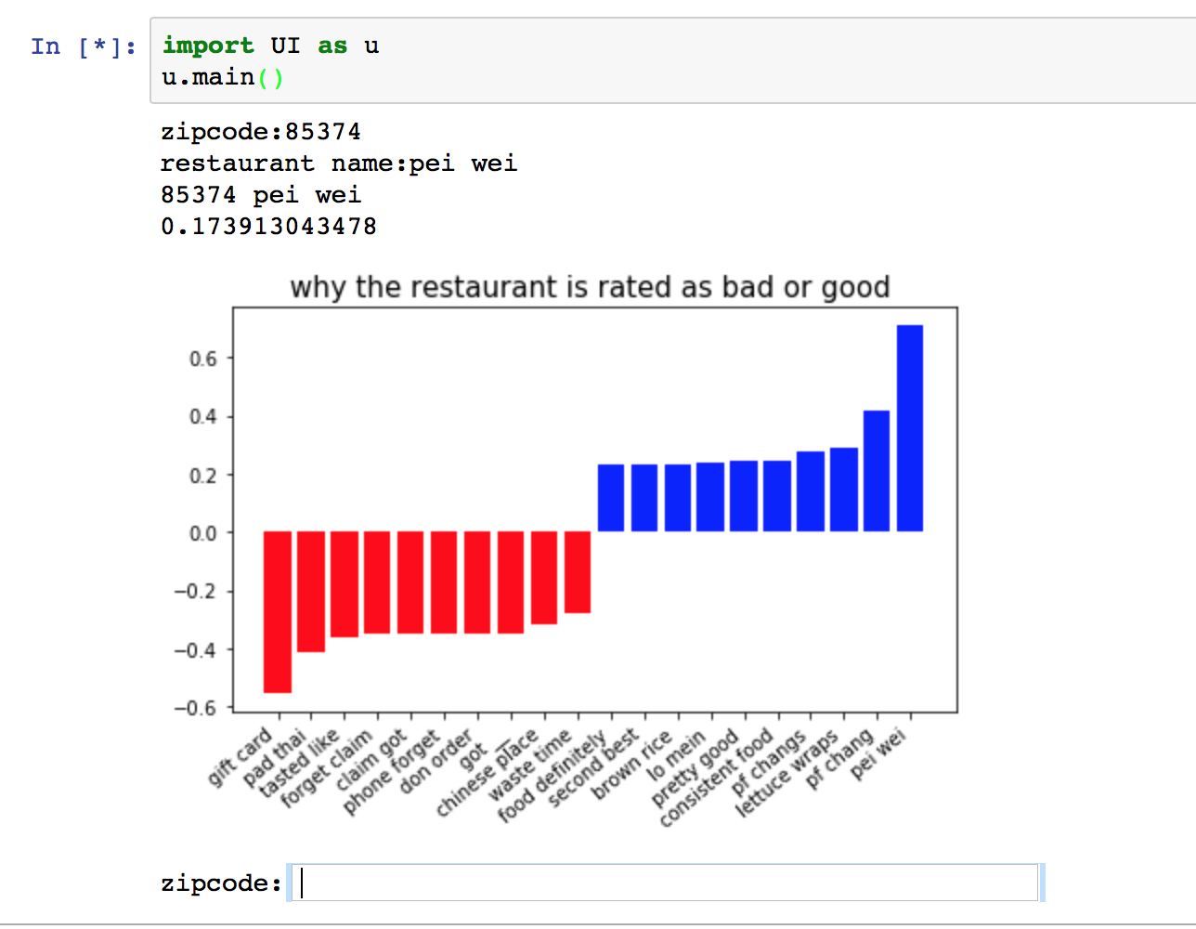
User Interface
User Output: { zip code, business name }
Fake review ratio =
# of fake reviews / #of total reviews
= 18%
Top 10 Positive and Negative Words:
Red ----- Negative
Blue ----- Positive

Slide 35

Q & A

Slide 36

Thank You

